Slide 1
AIRBNB LISTING ANALYSIS
Created by- dhruvi mehta

Slide 2
Dataset Link-https://www.kaggle.com/datasets/airbnb/seattle

Slide 3
Steps:-

Slide 4
1.Data Collection: Found a dataset of Airbnb listings in a city of Seattle from Kaggle. 2.Data Exploration: Loaded and examined the dataset to get a sense of its structure. Looked at the first few rows, data types, and basic statistics. 3.Data Cleaning: Handled missing values and cleaned the data. This involved filling missing values, removing duplicates, or correcting data inconsistencies.

Slide 5
Analysis:-

Slide 6




There are a total of 2114 listings in the dataset.
The total number of superhosts is 396.
The average of price per room type is 132.
The average of customer reviews per month is 2.16.

Slide 7
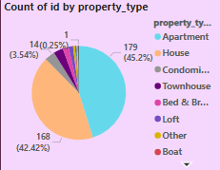
Percentage of different types of Airbnb in Seattle.
The above graph shows that there are more number of apartments compared to any other properties followed by houses in Seattle.

Slide 8
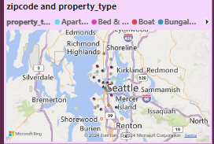
Location of properties in Seattle.
Using the above map we can get the information regarding the zipcode and the property type in Seattle.

Slide 9
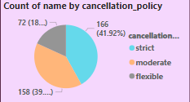
The above pie chart shows the number of properties with different types of cancellation policies.
Upon analysis, it shows that maximum number of properties have a strict cancellation policy followed by moderate cancellation policy.

Slide 10
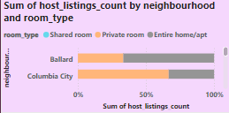
The above stacked bar graph shows the total number of listings with respect their room type.
Upon analysis, it shows that Columbia has the highest number of property listing consisting of 66.67% private rooms and remaining entire home/apartments.

